Slide 1
Recurrent Neural Network(RNN) Nangi Ramesh Junior Research Fellow CR.Rao AIMSCS

Slide 2
Agenda
What is Recurrent Neural Network(RNN) ?
Why it is?
RNN Architecture
Data sets
Applications
Advantages and Disadvantages of RNN
Issues With Recurrent Neural Network(RNN)

Slide 3
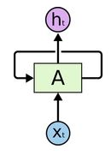
What is Recurrent Neural Network(RNN) ?
Recurrent Neural Network(RNN) are a type of Neural Network where the output from previous step are fed as input to the current step.

Slide 4
Why It is?
In traditional neural networks, all the inputs and outputs are independent of each other, but in cases like when it is required to predict the next word of a sentence, the previous words are required and hence there is a need to remember the previous words.
Thus RNN came into existence, which solved this issue with the help of a Hidden Layer. The main and most important feature of RNN is Hidden state, which remembers some information about a sequence

Slide 5
Training through RNN
A single time step of the input is provided to the network.
Then calculate its current state using set of current input and the previous state.
The current ht becomes ht-1 for the next time step.
One can go as many time steps according to the problem and join the information from all the previous states.
Once all the time steps are completed the final current state is used to calculate the output.
The output is then compared to the actual output (the target output) and the error is generated.
The error is then back-propagated to the network to update the weights and hence the network (RNN) is trained.

Slide 6
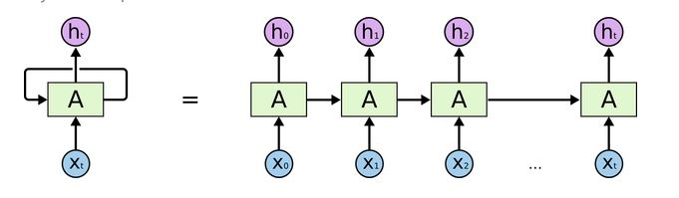
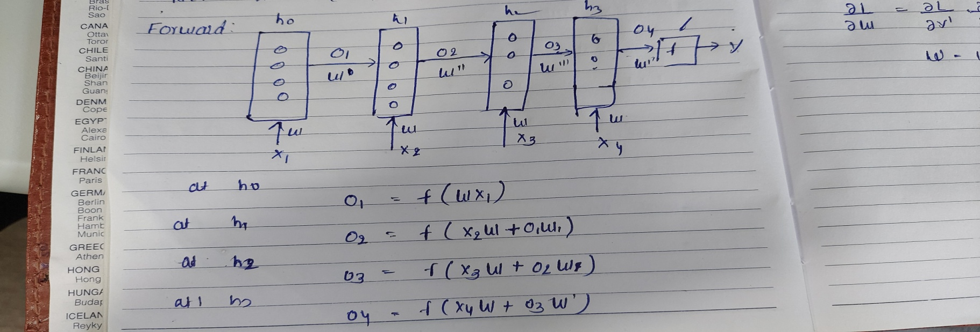
RNN Architecture
Forward Propagation

Slide 7
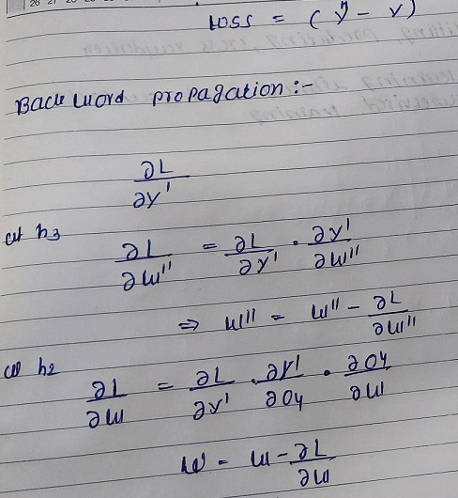
Backward Propagation

Slide 8
Data Sets
Time series Datasets
Sequential Datasets
Forecasting data sets

Slide 9
Applications
Sentimental analysis
Time series stocks forecasting
Speech to text conversion
language modeling
Building virtual assistance
Call center analysis
Prediction problems
Speech reorganization

Slide 10
Advantages and Disadvantages of RNN
Advantages
An RNN remembers each and every information through time. It is useful in time series prediction only because of the feature to remember previous inputs as well. This is called Long Short Term Memory.
Recurrent neural network are even used with convolution layers to extend the effective pixel neighborhood.
Disadvantages
Gradient vanishing and exploding problems.
Training an RNN is a very difficult task.
It cannot process very long sequences if using tanh or relu as an activation function.

Slide 11
Issues With Recurrent Neural Network(RNN) ?
Vanishing Gradients
This occurs when the gradients become very small and tend towards zero.
Exploding Gradients
This occurs when the gradients become too large due to back-propagation
To deal with such problems, two main variants of Recurrent Neural Networks were developed – Long Short Term Memory Networks and Gated Recurrent Unit Networks.

